Slide 1
Linear Regression Explained for beginners
What is Linear Regression ?
Theory of Linear Regression
Let’s do some hands-on in Python
Sajjad Mustafa

Slide 2
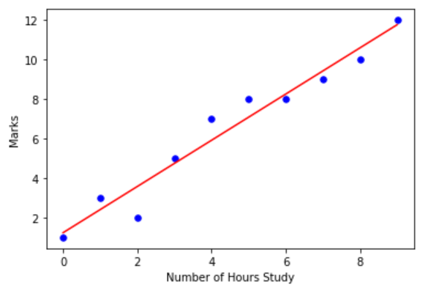
Linear Regression

Slide 3
Equation of Linear Line
Y = mX + c

Slide 4
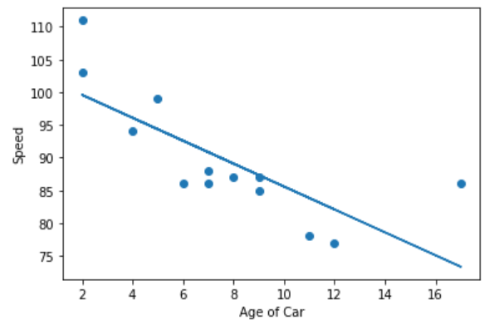
Prediction
Y = mX + c

Slide 5
Website : www.aisciences.io

